Slide 1



Guide
Making public transportation accessible
Group 3
Maggie Luong & Allyson Yu

Slide 2


UN Problem: No Poverty
38%
Importance
Economic growth must be inclusive to provide sustainable jobs and promote equality.
of people with visual impairments* have turned down a job because of public transportation concerns
Why?
The Septa Mobile Application is currently not accessible to all users.
16%
of Philadelphia citizens have a (dis)ability
Am I at the right stop?
Will the conductor announce the station?
Will I be able to safely get to and from work?”
* Encompasses individuals who may have lost their vision or may have difficulty with viewing

Slide 3


Making Public Transportation Accessible
Provides Philadelphians with visual impairments the opportunity to
Promotes equitable access to public transportation
Commute to work via subway safely
Passage to labor, which can combat poverty
Encourages reliability to employment
Barrier to employment

Slide 4
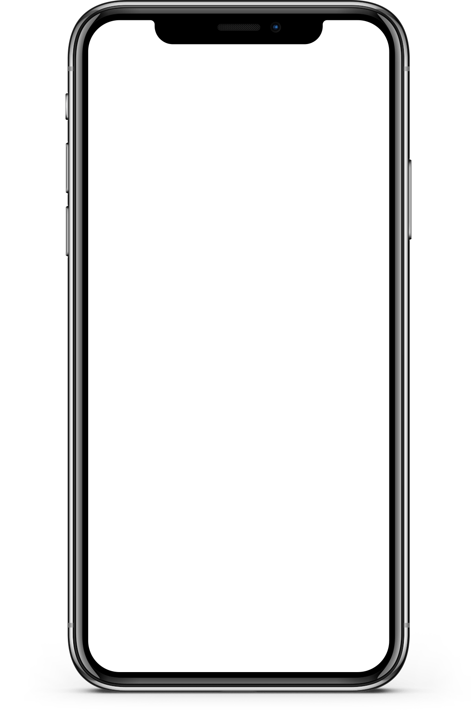
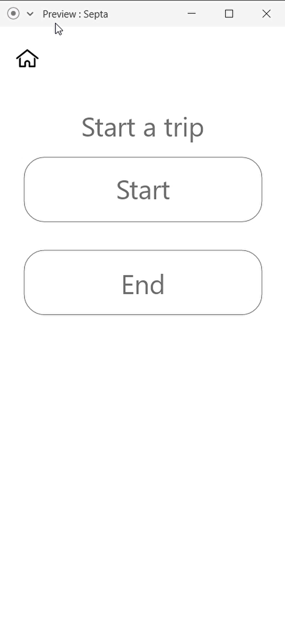
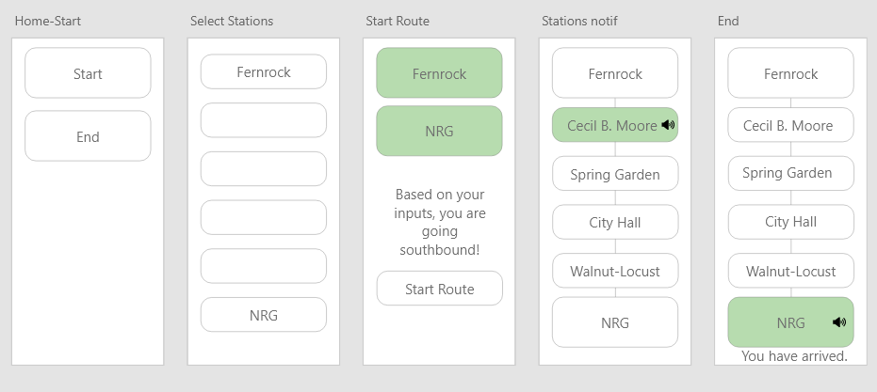
Prototype
User Interface
Sketch of UI
*Prototype video automatically plays

Slide 5
Prototype link
https://mis3502-luong.com/septa/

Slide 6

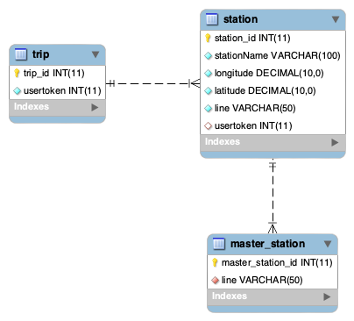
Schema

Slide 7
Features
User Pain Points
Am I at the right stop?
Will the conductor announce the station?
Will I be able to safely get to and from work?”
http://mis3502-luong.com:8222
POST /trip
User will create a new trip record. The usertoken will be passed as a parameter to help identify the trip(s) created by the user. User must input two stations (station_id). One is for the start station, and one is for the end station. If the POST is successful, the user will be able to create a new trip.
GET /itinerary
Issue a GET to retrieve the details of the trip. If the GET is successful, the start station, end station, and stations in between will be displayed.
GET /history
Issue a GET to retrieve the user's trip history, sorted by most recent trip. This feature provides our intended audience with the convenience of not having to re-enter their trips repeatedly.

Slide 8
Third-Party APIs
Septa Alerts with Message
Vibration
Notifications
Text to Speech API

Slide 9
Innovation
Feature does not exist... yet
User Experience (UX)
Septa app does not have a feature dedicated to individuals with visual impairments
Follows Web Content Accessibility Guidelines (WCAG) 2.1 for mobile applications
Intuitive & accessible
Geo-location
External tools
Informs the user by referencing the longitude and latitude of the station
Provides vibration at the station
Phone accessibility features

Slide 10


Business Considerations
Enhance diversity and inclusion
Minimize legal risk
Drive innovation

Slide 11
Next Steps
Improve the look and feel to fit SEPTA
Minimize legal risk
Drive innovation

Slide 12
Thank You
Questions?

